Slide 1
Zomato Data Analysis Project
Importing Required Libraries:
Zomato has an average of 17.5 million monthly transacting customers for its food delivery business. The average number of monthly active restaurant partners on Zomato’s platform has grown 8.7% year-on-year, from 208,000 to 226,000. As a data professional in a data-driven role at Zomato, you are tasked with analyzing the customer dataset. Your responsibilities include performing Exploratory Data Analysis (EDA) and creating visualizations to answer key business questions and derive insights.

Slide 2
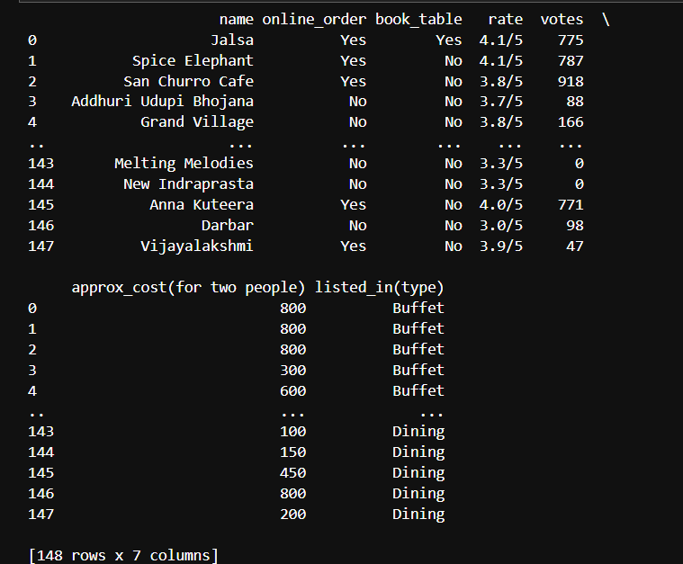
Zomato Data Analysis Project

Slide 3
Zomato Data Analysis Project
1) What type of restaurant do the majority of customers order from?
2) How many votes has each type of restaurant received from customers?
3) What are the ratings that the majority of restaurants have received?
4)Zomato has observed that most couples order their food online. What is their
average spending on each order?
5) Which mode (online or offline) has received the maximum rating?
6) Which type of restaurant received more offline orders, so that Zomato can provide those customers with some good offers?

Slide 4
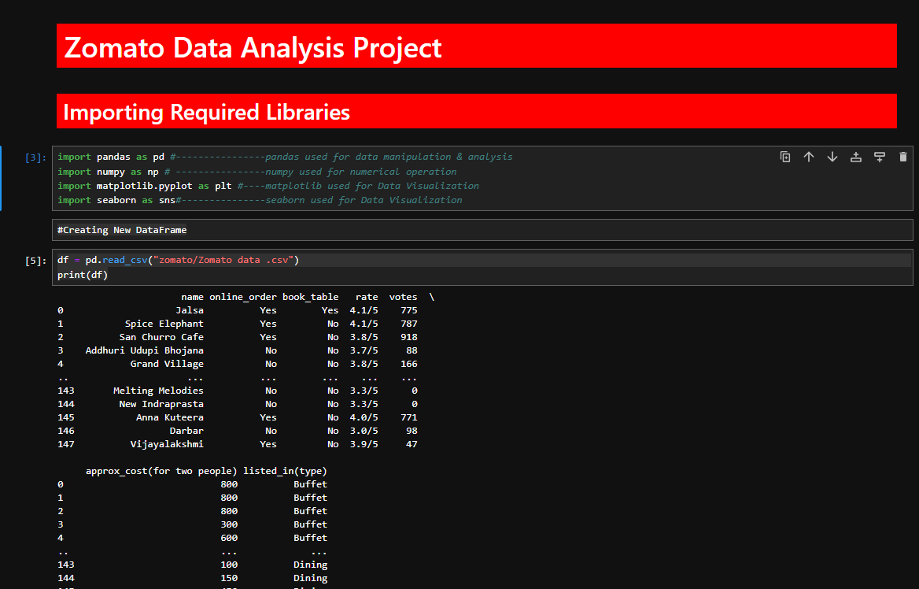

Slide 5
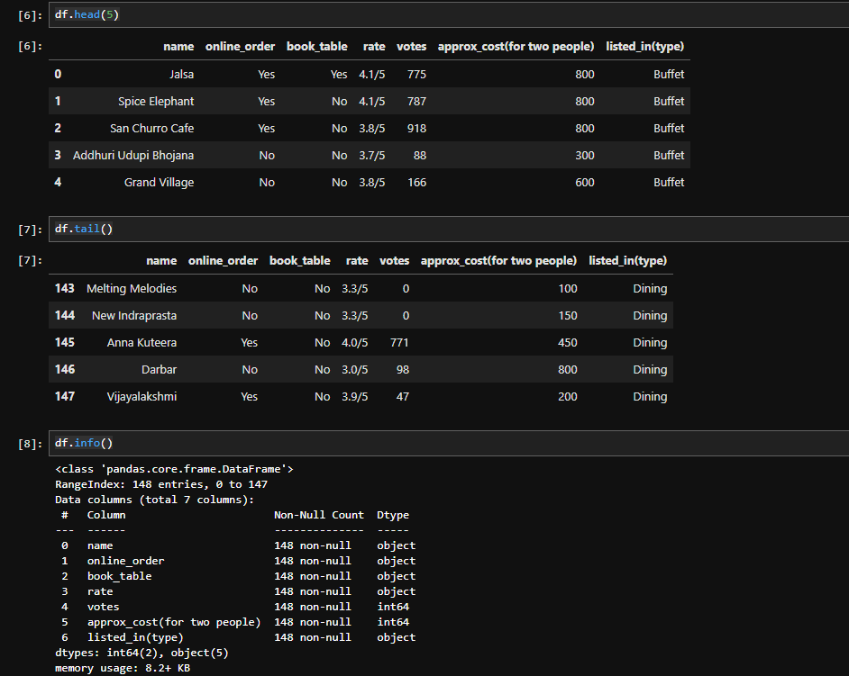

Slide 6
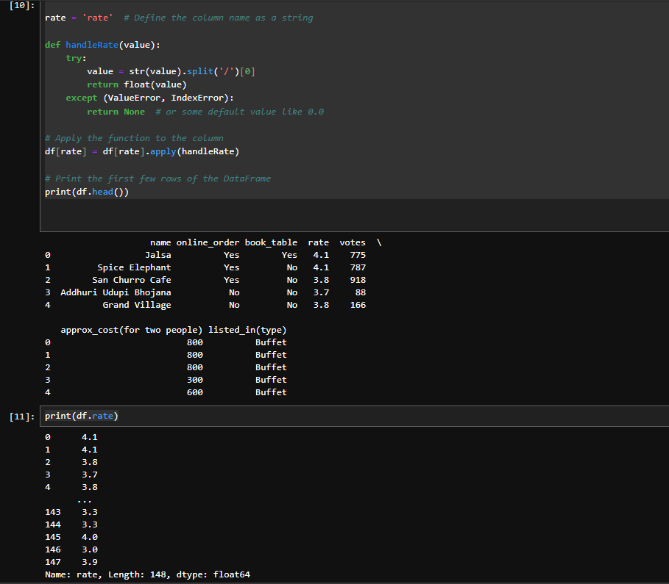

Slide 7
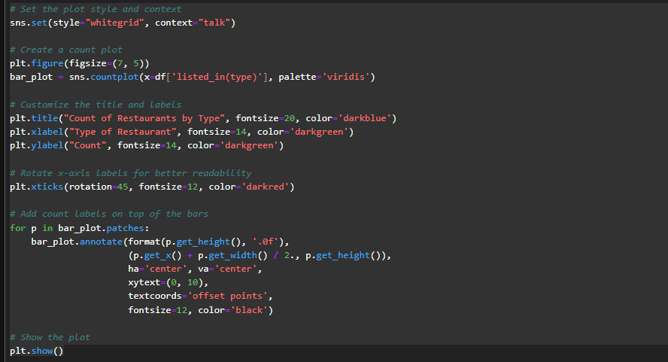
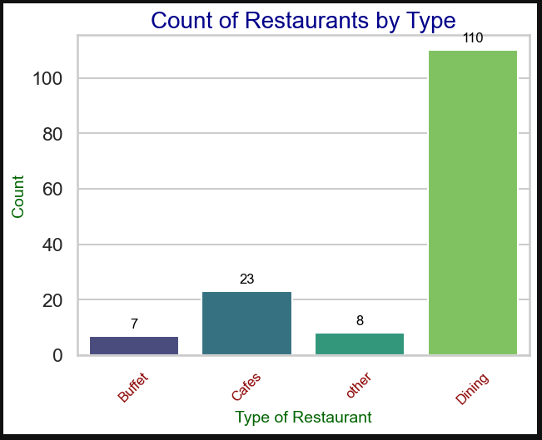

Slide 8
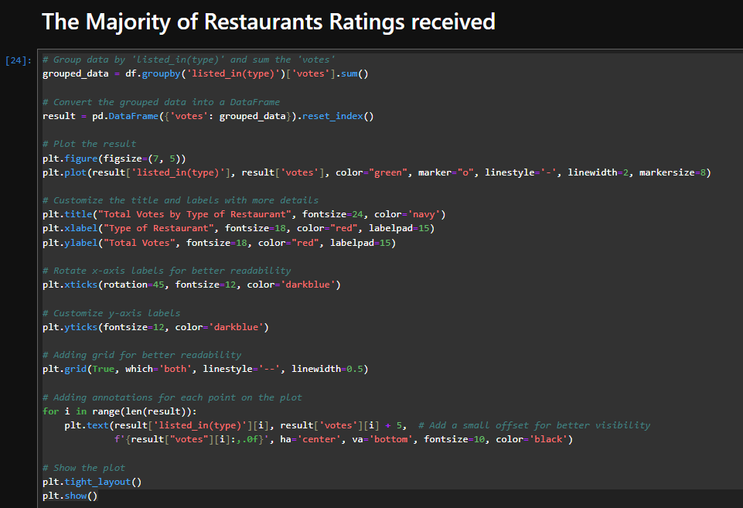
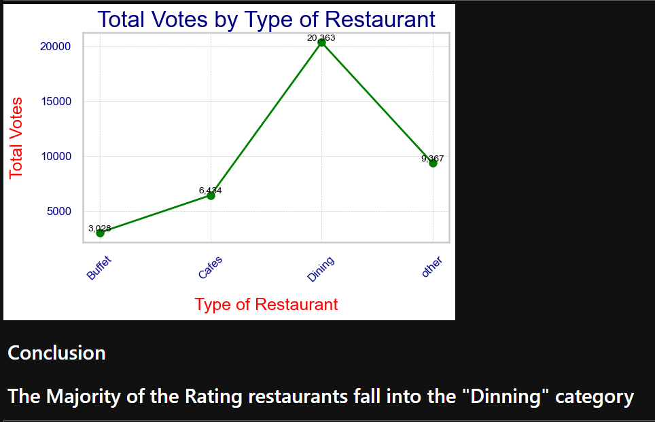

Slide 9
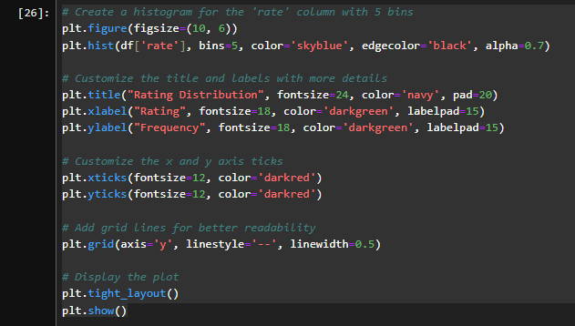
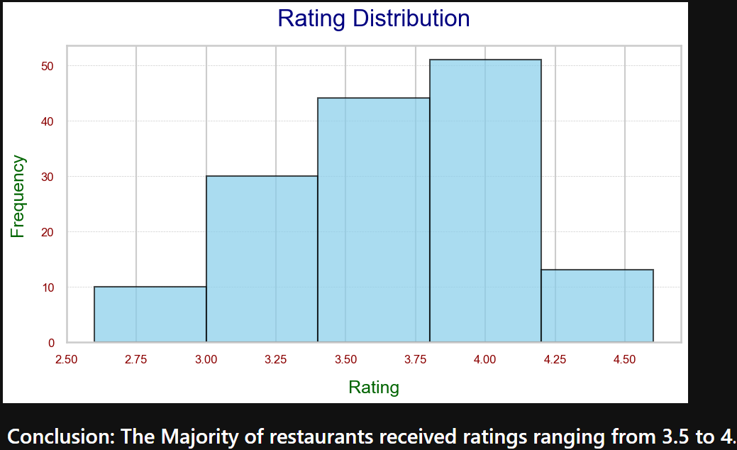

Slide 10
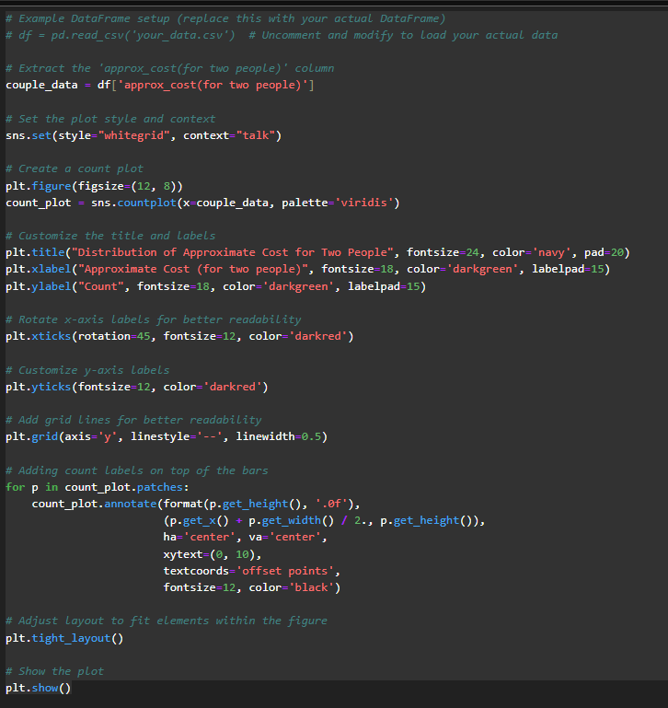

Slide 11
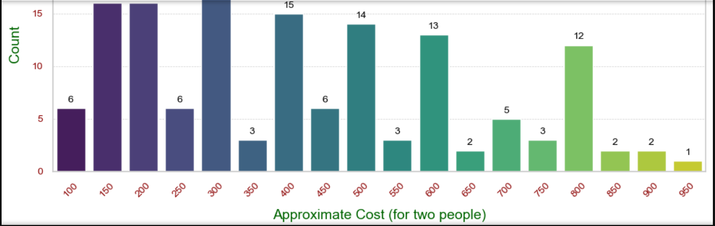

Slide 12
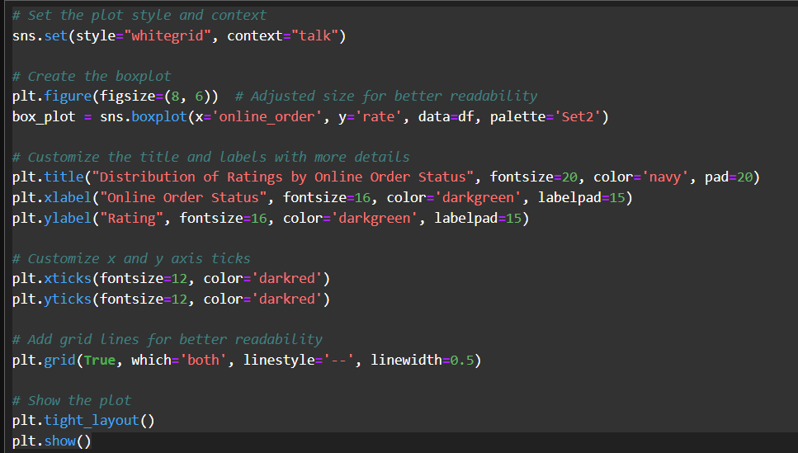
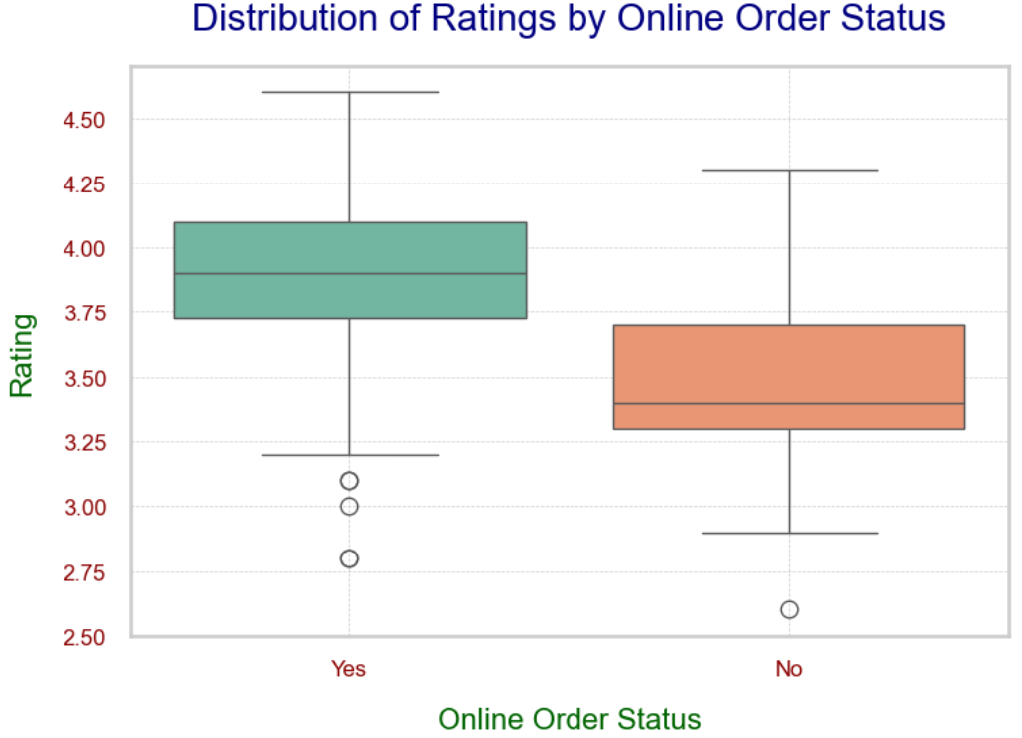

Slide 13
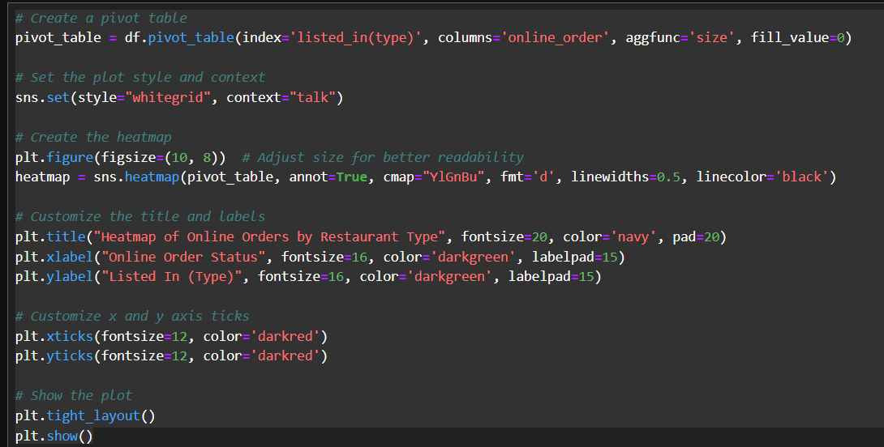
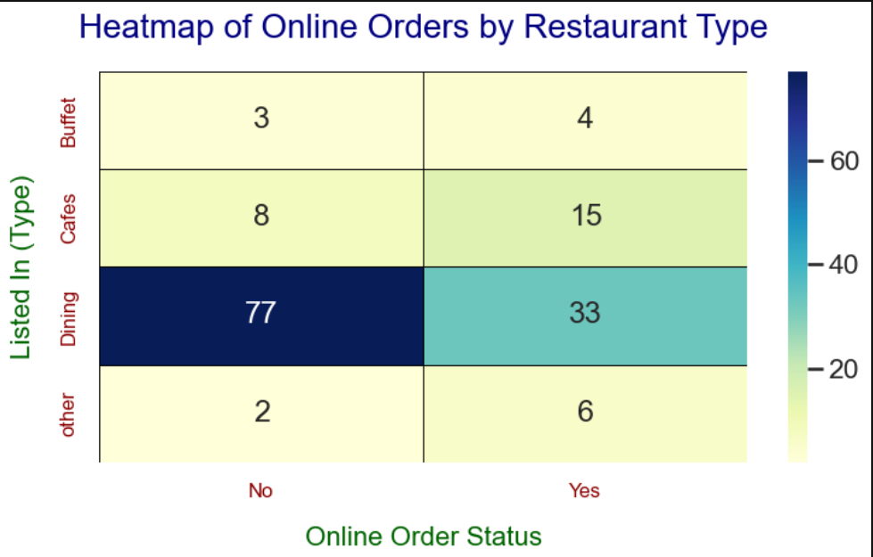

Slide 14
